Slide 1

PROPHET
Student name: Minh Tien, Ta.
Student id: 1130

Slide 2
Table of contents
WHAT
WHY
01
02
HOW
DEMO + LIMITATION
03
04
Time series problem
Prophet
Trend + seasonality + holiday
Strengths or advantages
Comparision with other ML models
Understand hyper-parameters
Stream-lit
Adjust the parameters

Slide 3

01
WHAT IS PROPHET ?

Slide 4
PROPHET BACKGROUND
- proposed by Facebook (meta) data research team.
- open-source algorithm for generating time-series models.
- Support for R and Python.

Slide 5

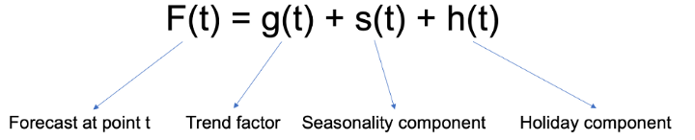


Main factors
TREND
SEASONALIY
HOLIDAY/EVENT
Linear and Logistic
Fourier Series
Christmas/New Years, holiday weekends, thanksgiving’s association with Black Friday/Cyber Monday

Slide 6
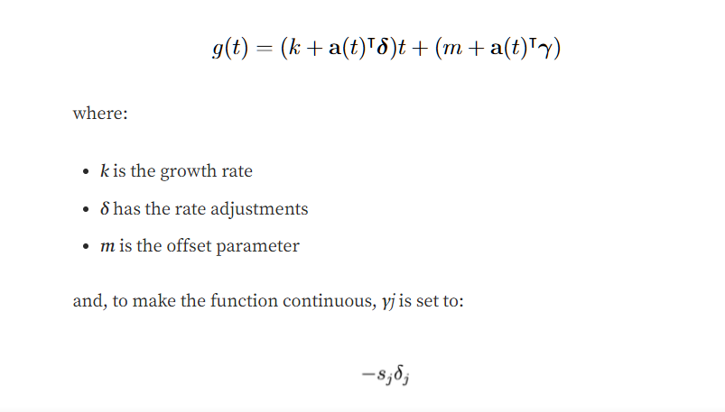
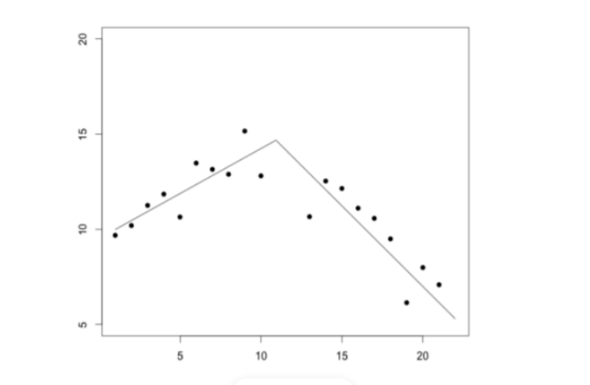
Trend factors
Linear Trend with Changepoints
Trend model is a simple Piecewise Linear Model with a constant rate of growth.
Notes:
It is a simple modification of linear model, yet very useful. Different ranges of 𝑥, different linear relationships occur

Slide 7
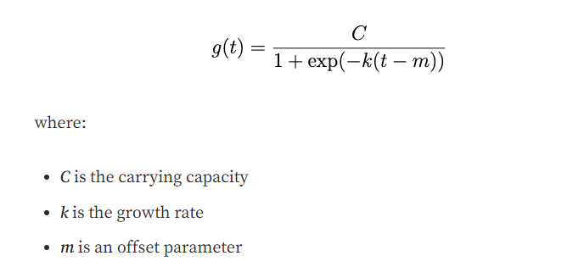
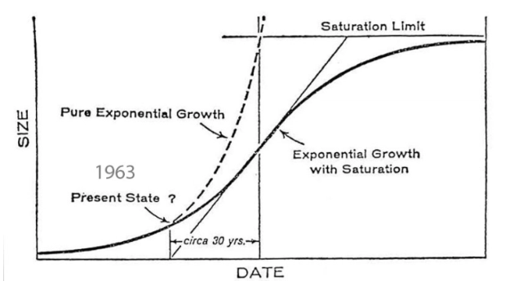
Trend factors
Logistic growth model
Non-linear growth with saturation — The initial stage of growth is approximately exponential (geometric), as saturation begins, the growth slows to linear (arithmetic) and at maturity, growth stops.

Slide 8
Main factors
TREND
SEASONALIY
HOLIDAY/EVENT
Linear and Logistic
Fourier Series
Christmas/New Years, holiday weekends, thanksgiving’s association with Black Friday/Cyber Monday

Slide 9
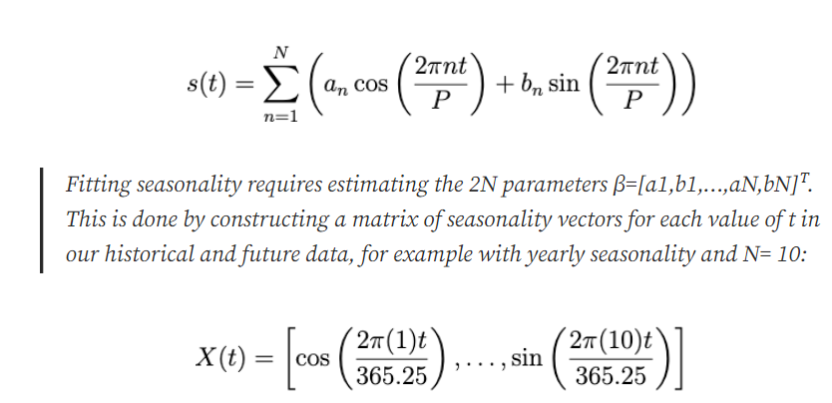
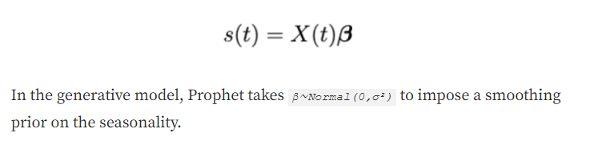
Seasonality factors
The seasonal component s(t) provides a adaptability to the model by allowing periodic changes based on sub-daily, daily, weekly and yearly seasonality.

Slide 10
Main factors
TREND
SEASONALIY
HOLIDAY/EVENT
Linear and Logistic
Fourier Series
Christmas/New Years, holiday weekends, thanksgiving’s association with Black Friday/Cyber Monday

Slide 11
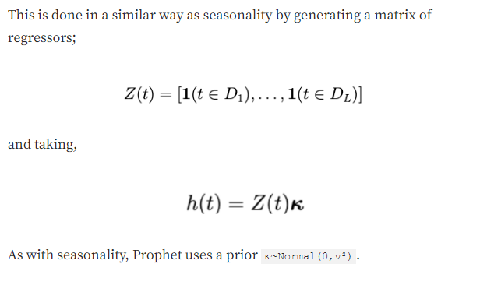
Holiday factors
Impact of a particular holiday on the time series is often similar year after year, making it an important incorporation into the forecast.
The component h(t) speaks for predictable events of the year including those on irregular schedules (e.g. Black Friday or the Superbowl).

Slide 12

02
WHY WE SHOULD USE PROPHET?

Slide 13
WHY
THE PROS
1. Accurate and fast - Prophet is accurate and fast. It is used in many applications across Facebook for producing reliable forecasts for planning and goal setting.
2. Fully automatic - Prophet is fully automatic. We will get a reasonable forecast on messy data with no manual effort.
3. Tunable forecasts - Prophet produces adjustable forecasts. It includes many possibilities for users to tweak and adjust forecasts. We can use human-interpretable parameters to improve the forecast by adding our domain knowledge.
4. Robust to outliers - It is robust to outliers. It handles outliers by removing them.
5. Robust to missing data - Prophet is resilient to missing data

Slide 14
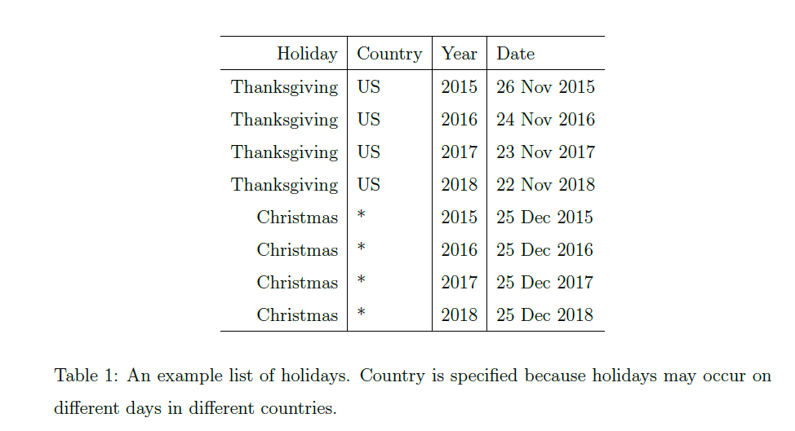
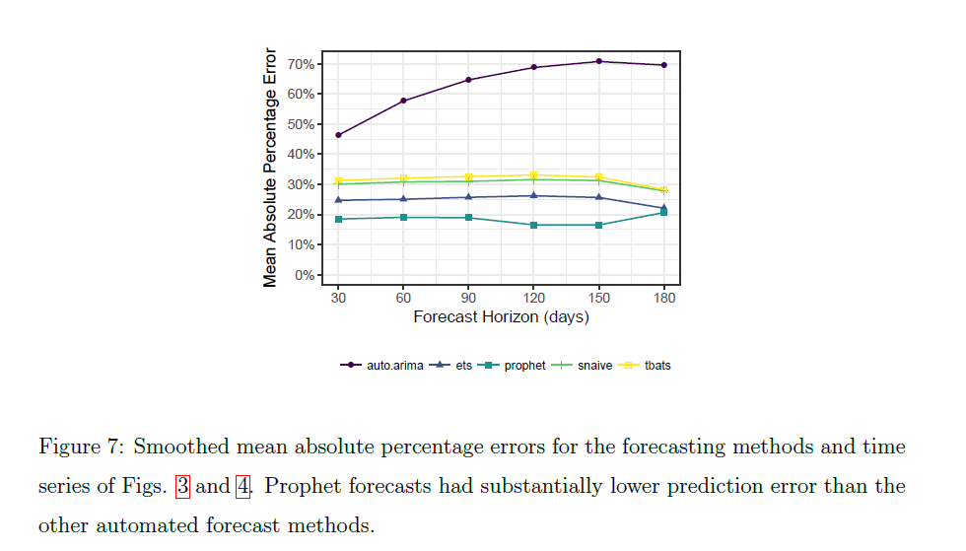
WHY
1. One of the best choice for demand forecast.
2. Fitting well with non-Gaussian distribution.
3. Tune parameters based on business domain.

Slide 15

03
HOW WE CAN USE PROPHET?

Slide 16
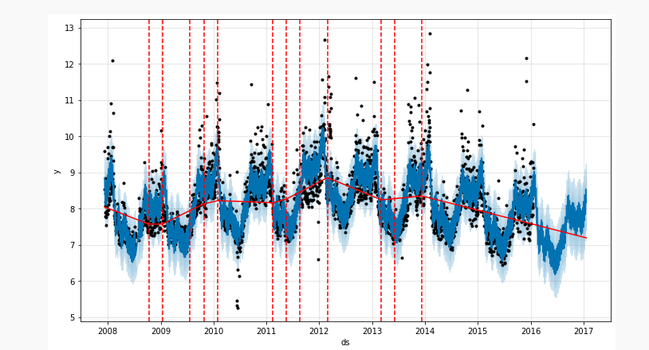
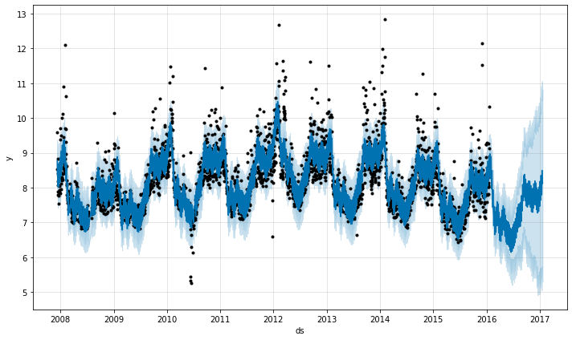
HOW
Parameters for trend
Parameters | Description
growth | linear’ or ‘logistic’ to specify a linear or logistic trend
changepoints | List of dates at which to include potential changepoints (automatic if not specified)
n_changepoints | If changepoints in not supplied, you may provide the number of changepoints to be automatically included - default: 25 change points
changepoint_prior_scale | Parameter for changing flexibility of automatic changepoint selection - decreasing: less flexible ; increasing: more flexible
changepoint_range | changepoint_range is a value between 0 and 1 indicating the percentage of historical data that allow a trend change.
Figure1: change point in training set
Figure2: changepoint_prior_scale = 10

Slide 17
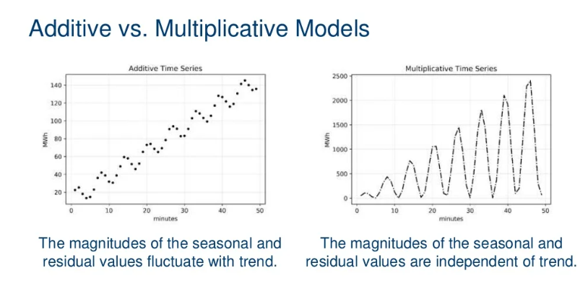
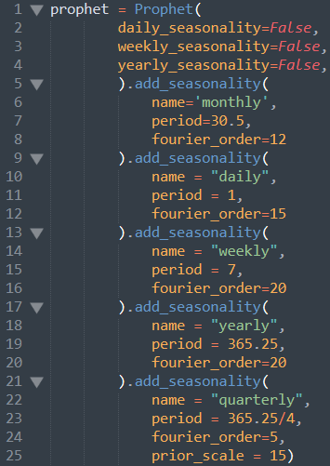
HOW
Parameters for seasonality
Parameters | Description
seasonality_mode | Default is 'additive', but many business time series will have multiplicative seasonality. - Values: additive / multiplicative
yearly_seasonality | Fit yearly seasonality. - Values: True/False
weekly_seasonality | Fit weekly seasonality. - Values: True/False
daily_seasonality | Fit daily seasonality - Values: True/False
seasonality_prior_ scale | Parameter for changing strength of seasonality model - Values: a range 0 -> infinity

Slide 18
HOW
Parameters for holiday
Parameters | Description
holidays | Feed dataframe containing holiday name and date.
holiday_prior_scale | Parameter for changing strength of holiday model

Slide 19

04
DEMO & LIMITATION

Slide 20
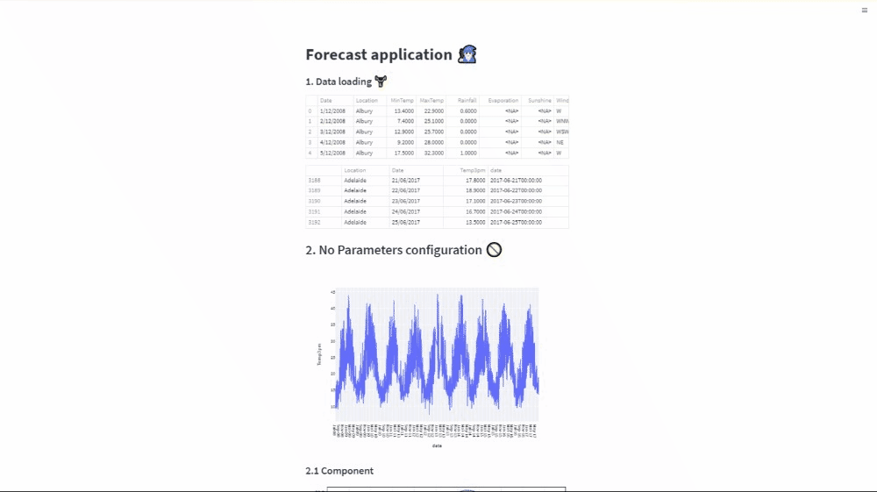
DEMO

Slide 21
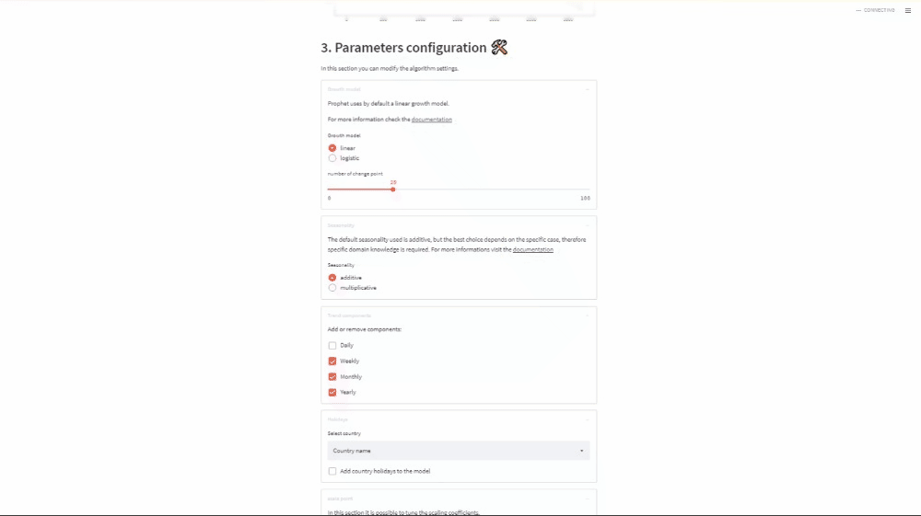
DEMO

Slide 22
LIMITATION
1. The challenge with Facebook Prophet is that it does not look for casual relationships between the past and the future. It simply finds the best curve to fit the data using a linear logistic curve component for the external regressor.

Slide 23
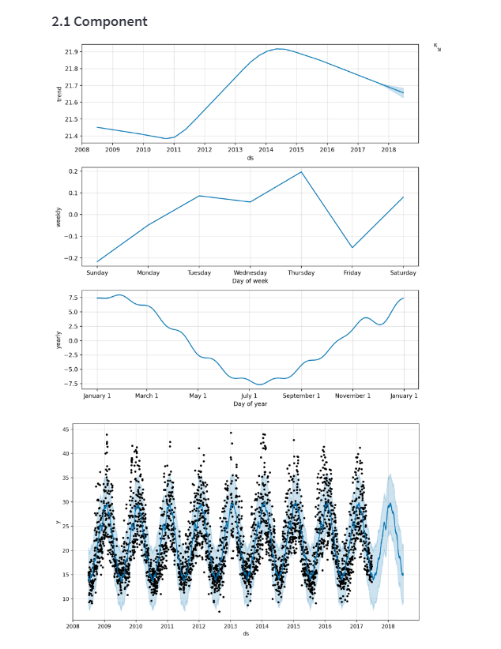
DEMO

Slide 24
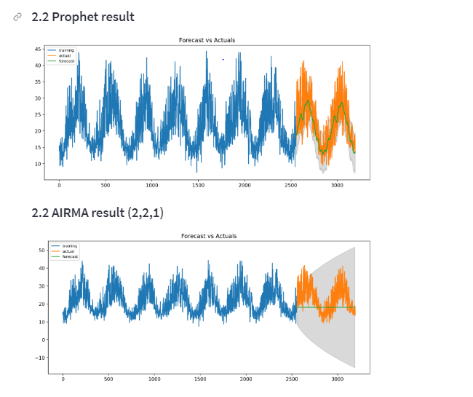
DEMO

Slide 25
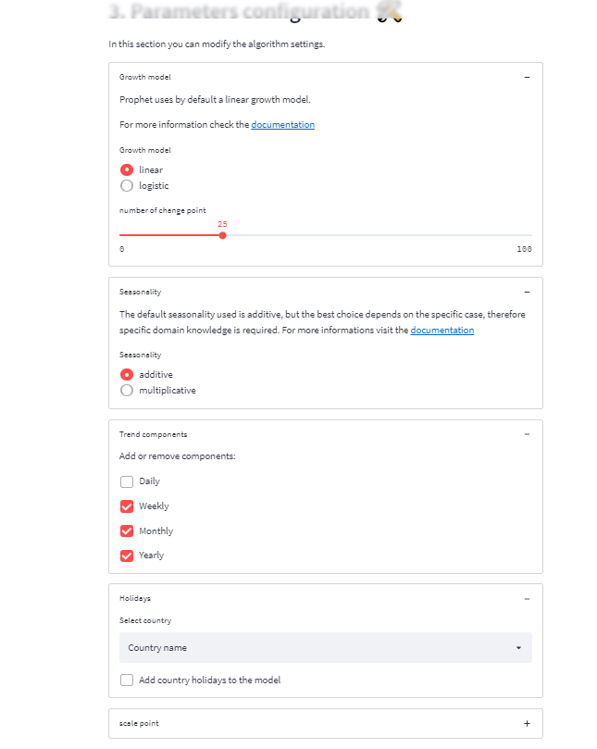
DEMO

Slide 26
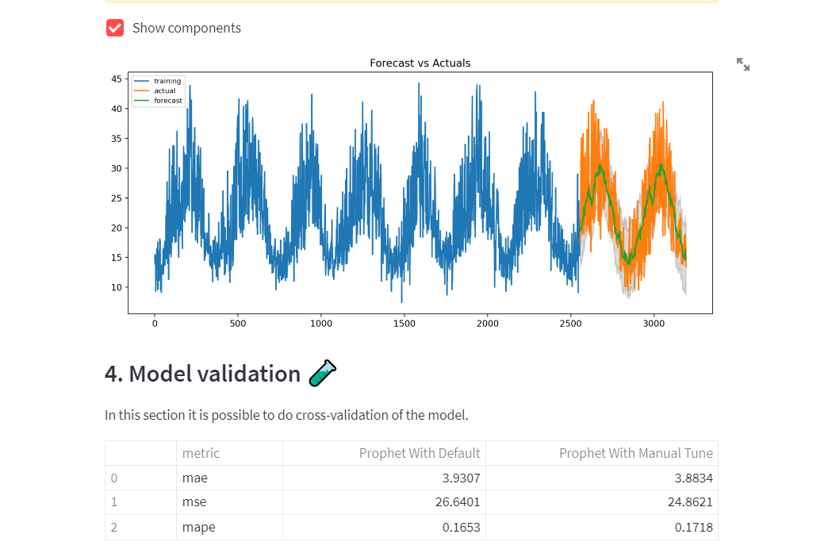
DEMO

Slide 27
DEMO
Parameters for trend

